Slide 1
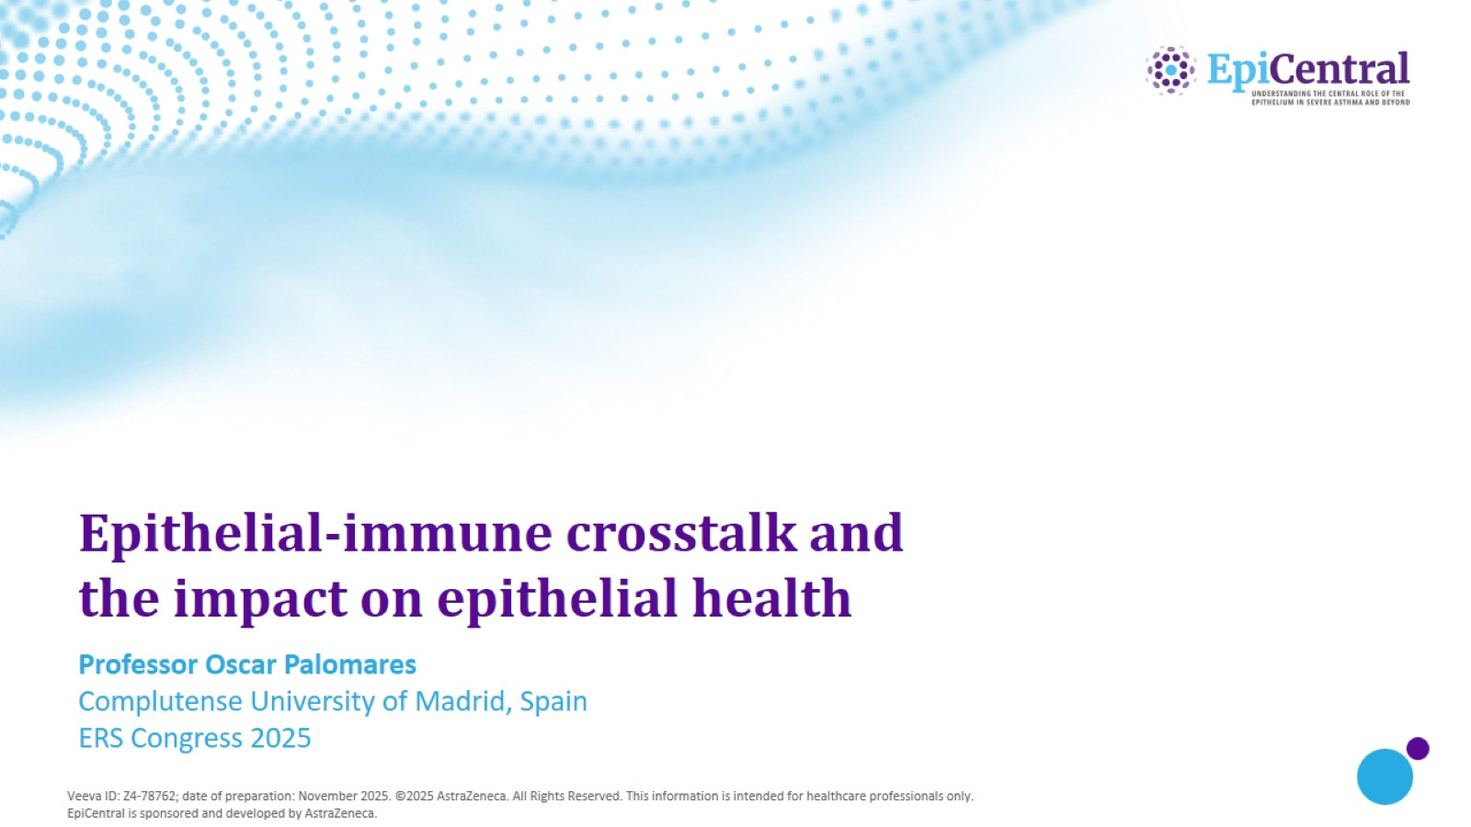
Epithelial-immune crosstalk and the impact on epithelial health

Slide 2
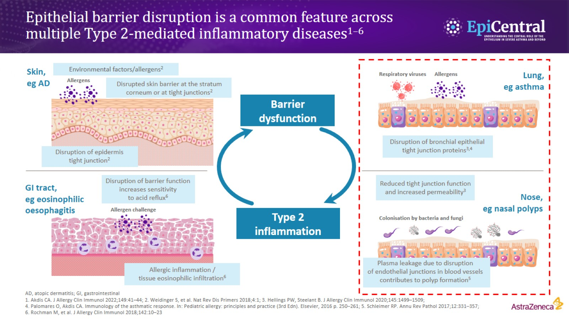
Epithelial barrier disruption is a common feature across multiple Type 2-mediated inflammatory diseases^{1–6}

Slide 3
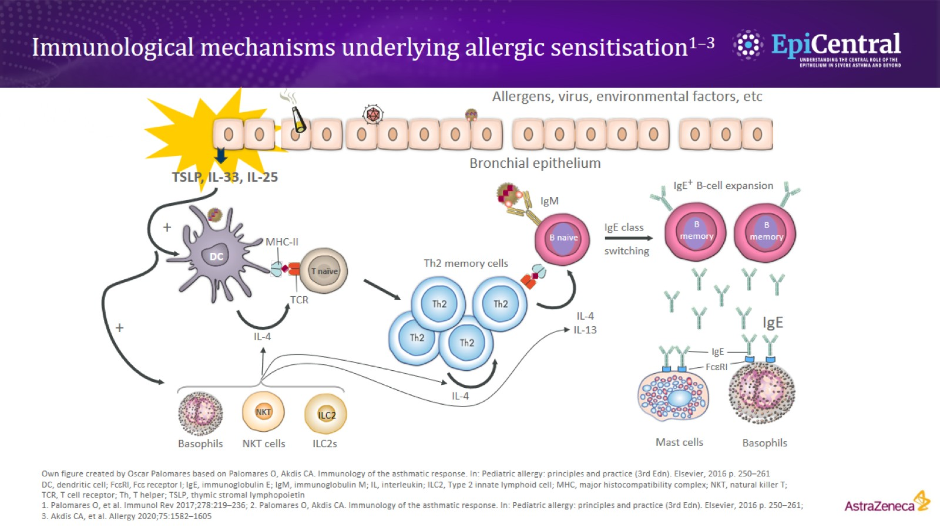

Slide 4
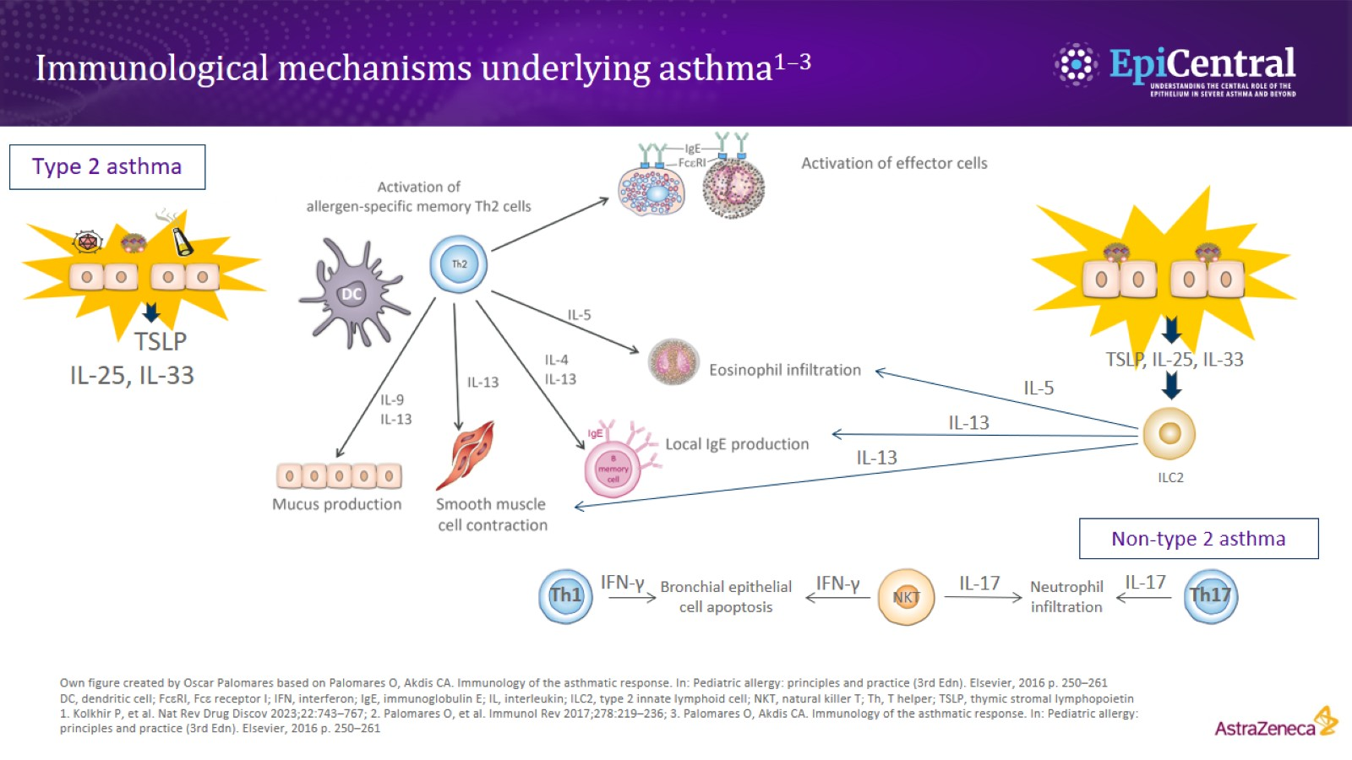

Slide 5
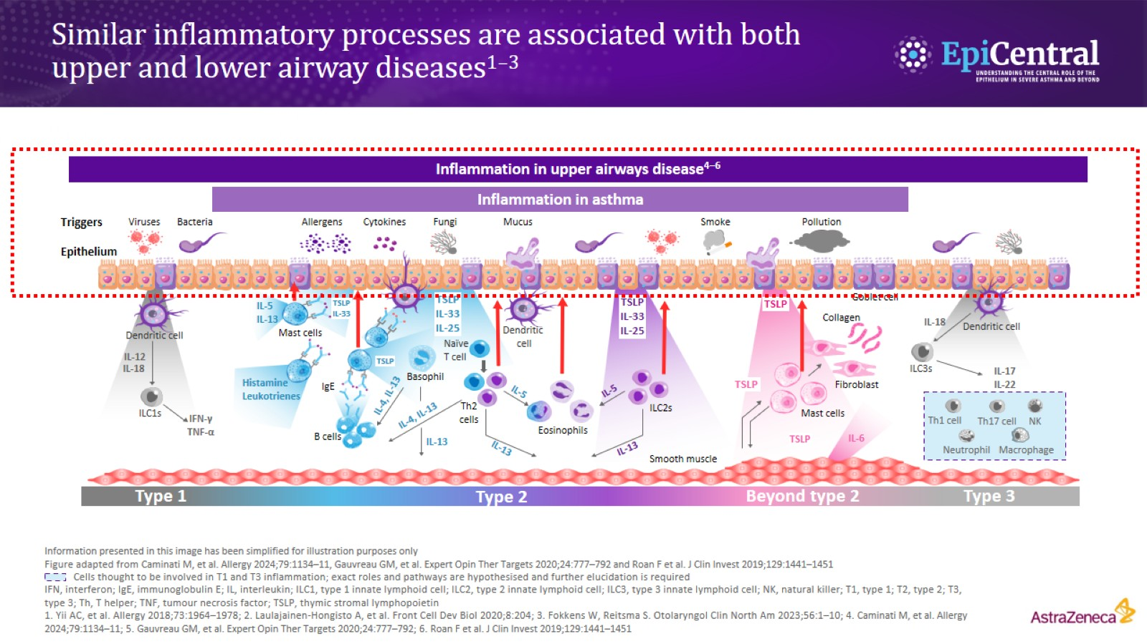
Similar inflammatory processes are associated with both upper and lower airway diseases^{1–3}

Slide 6
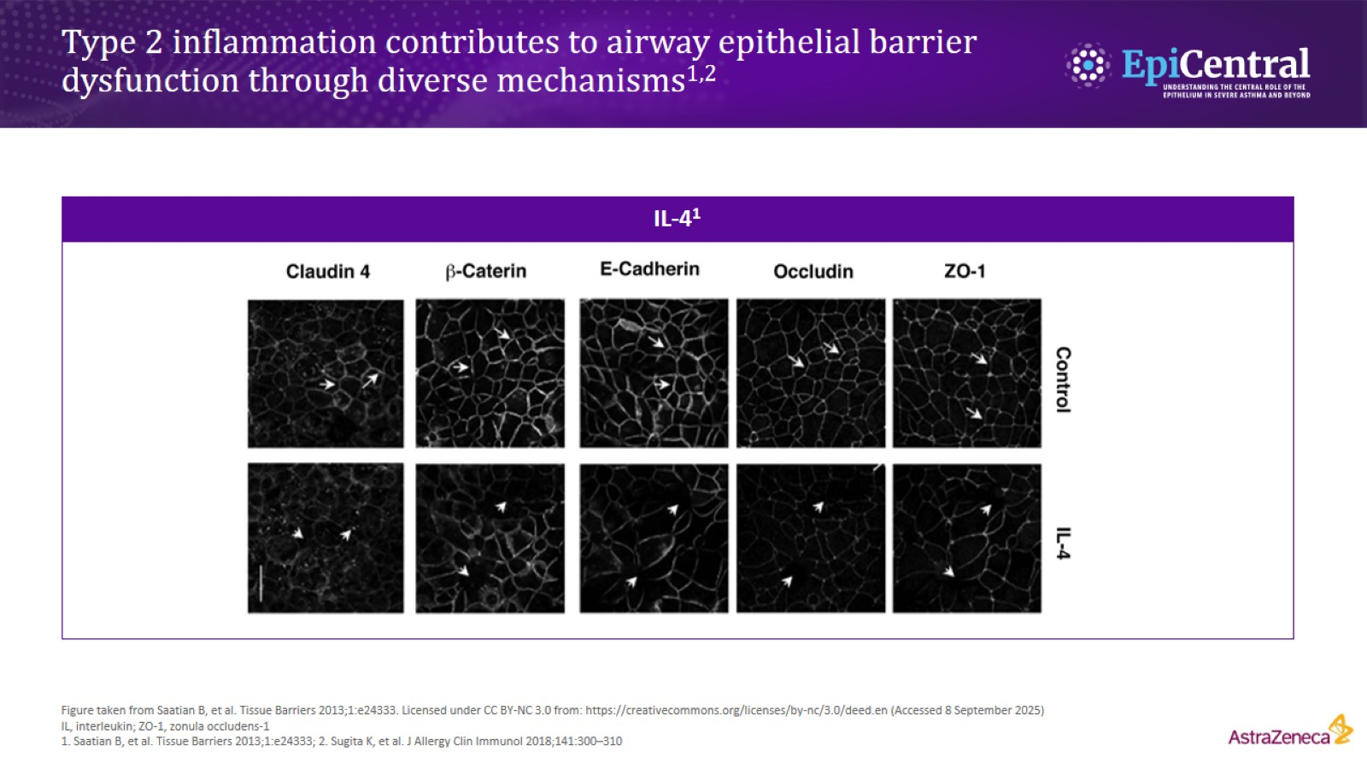
Type 2 inflammation contributes to airway epithelial barrier dysfunction through diverse mechanisms^{1,2}

Slide 7
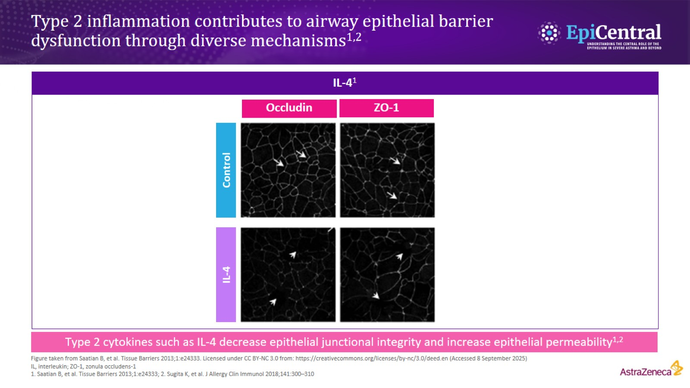
Type 2 inflammation contributes to airway epithelial barrier dysfunction through diverse mechanisms^{1,2}

Slide 8
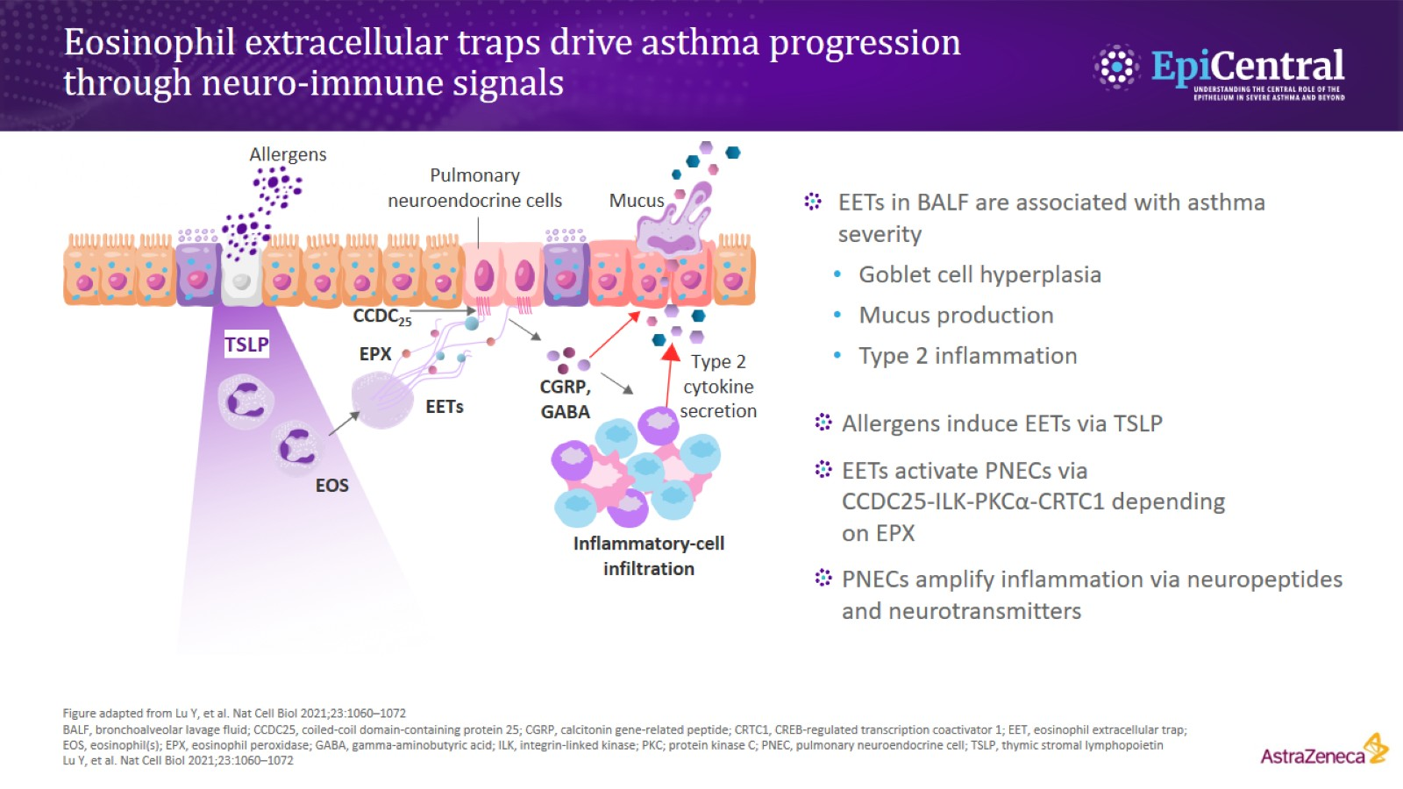
Eosinophil extracellular traps drive asthma progression through neuro-immune signals

Slide 9
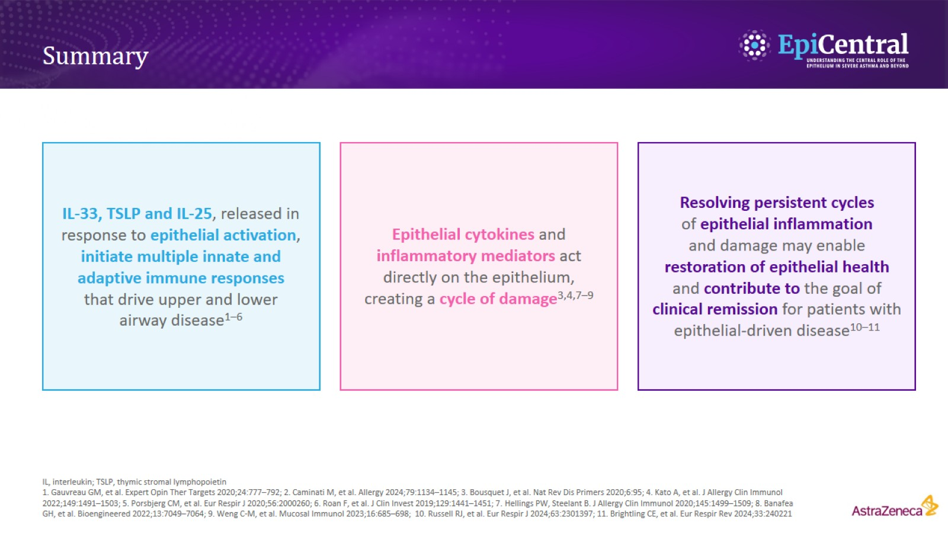
Summary

